Slide 1
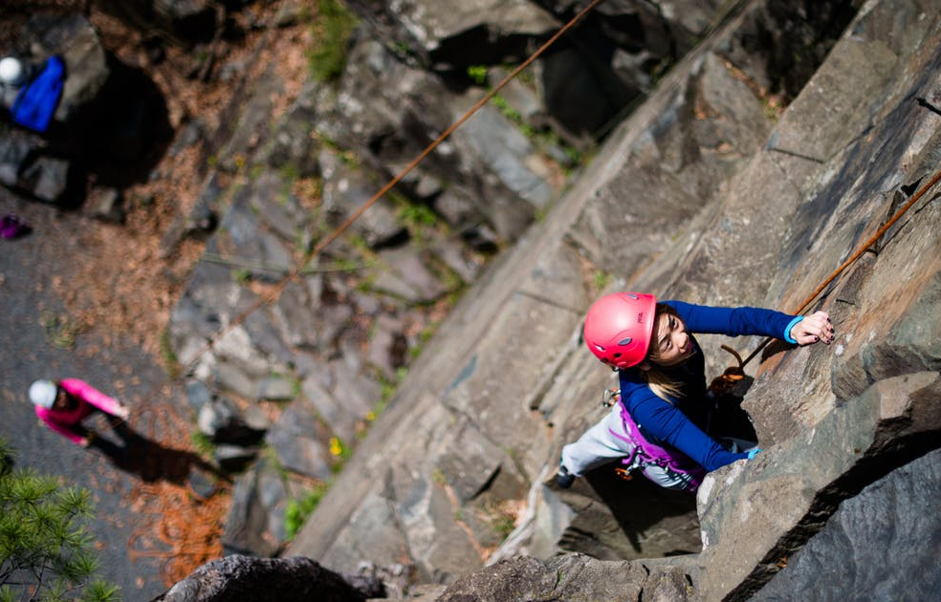



6-8 BCML Session 4
Building a Culture of Math Learning, Grades 6 - 8
Topic 2: Focusing on SMP 1
Session 4: Shared Learning

Slide 2
12 Week Content Cycle Overview
Building a Culture of Math Learning
The Standards for Mathematical Practice support a culture of math learning where students feel empowered to take academic risks, persevere in problem solving, make meaning of mathematics, explain their thinking, and reflect on their own learning.
12-week Content Cycle
Introduction to the Standards for Mathematical Practice (SMPs) | SMP 1: Make sense of problems and persevere in solving them. | SMP 4: Model with mathematics. | SMP 3: Construct viable arguments and critique the reasoning of others.
Week 1: Shared Learning Week 2: Planning & Practice Week 3: Student Progress | Week 1: Shared Learning Week 2: Planning & Practice Week 3: Student Progress | Week 1: Shared Learning Week 2: Planning & Practice Week 3: Student Progress | Week 1: Shared Learning Week 2: Planning & Practice Week 3: Student Progress
2

Slide 3


Norms
Our Norms
Add your school or team norms here
3

Slide 4
Objectives
Agenda
Internalize the language and look-fors of SMP 1 and draw connections between SMP 1 competencies and increased student access to conceptual understanding
Analyze specific teacher planning and instructional moves around incorporating SMP 1 within the lesson and the impact on student learning
Revisit SMP 1
Create an exemplar student response to a task by determining the target of the standard
Observe teacher moves in utilizing SMP 1 to increase student access to conceptual understanding
Reconnect to our “Why” - Equity
Reflect on Criteria for Success
Closing and next steps
4

Slide 5

Preview Criteria for Success
These are the look-fors we will be focusing on during Topic 2.
As we go through the session, identify connections between today’s learning and progress toward these look-fors.
Handout 1 - Page 5
5

Slide 6
Focusing on SMP 1
SMP 1: Make sense of problems and persevere in solving them.
Jot down your key takeaways on SMPs 1 from last week’s session. What would utilizing SMP 1 look like for students?
Post-it Note
6

Slide 7
SMP 1 Share-Out
Mathematically proficient students start by explaining the meaning of a problem and looking for entry points to its solution.
They analyze givens, constraints, relationships and goals.
They make conjectures about the form and meaning of the solution and plan a solution pathway, rather than simply jumping into a solution attempt.
Post-it Note
7

Slide 8
SMP 1 Share-Out
They consider analogous problems and try special cases and simpler forms of the original problem in order to gain insight into its solution.
They monitor and evaluate their progress and change course, if necessary.
Older students might, depending on the context of the problem, transform algebraic expressions or change the viewing window on their graphing calculator to get the information they need.
8
Post-it Note

Slide 9
SMP 1 Share-Out
Mathematically proficient students can explain correspondences between equations, verbal descriptions, tables and graphs, or draw diagrams of important features and relationships, graph data and search for regularity or trends.
Younger students might rely on using concrete
objects or pictures to help conceptualize and solve a problem.
Post-it Note
9

Slide 10
SMP 1 Share-Out
Mathematically proficient students check their answers to problems using a different method and they continually ask themselves, "Does this make sense?"
They can understand other approaches to solving complex problems and identify correspondences between different approaches.
Post-it Note
10

Slide 11
Creating Exemplar Student Responses
Our Process: We’ll be using an annotated version of the Lesson Planning Tool.
Read the KAS for Mathematics and task aloud.
Create exemplar student responses and consider the questions that follow the task.
Handout 1
11

Slide 12
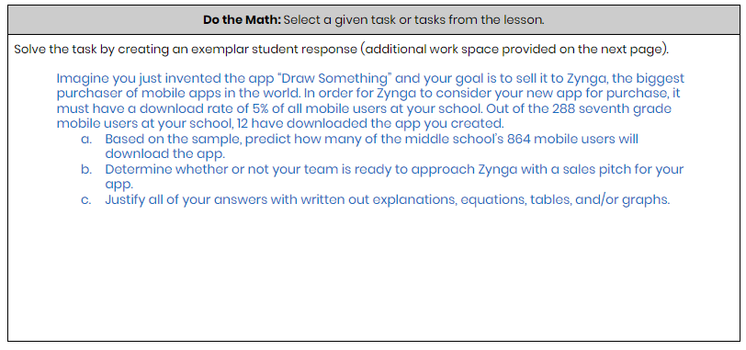
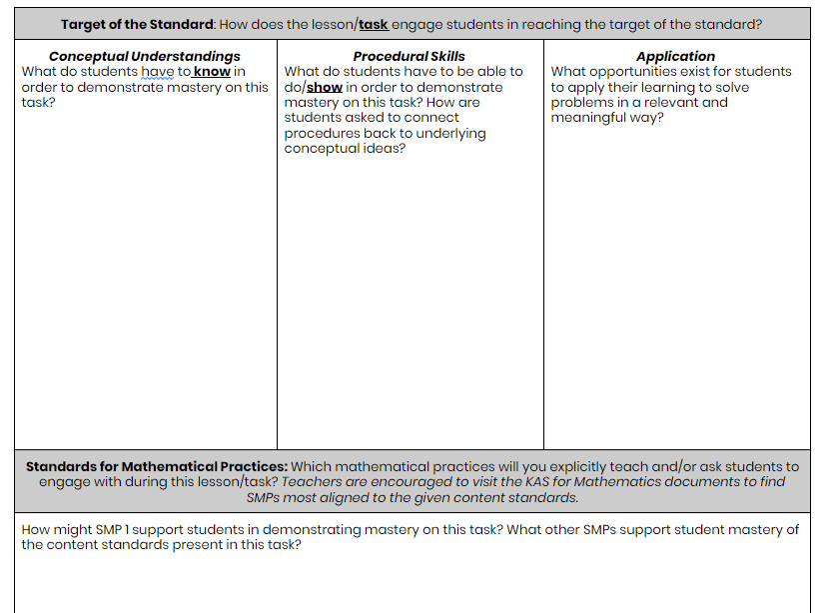
Task Share Out: Grades 6-8
Handout 1
12

Slide 13
SMP 1 in Action: Grades 6-8
Video Observation
Massachusetts DESE
7th Grade Problem Solving/Graphing
(min 0:00 - 4:35)
Handout 1
13

Slide 14
Video Share Out: Grades 6-8
What planning steps did the teacher take to incorporate these SMP 1 into her instruction?
What instructional moves did the teacher take to incorporate SMP 1 into her lesson? What impact did this have on students?
14

Slide 15
Instructional Share Out: Grades 6-8
In what ways have you already incorporated SMP 1 into your instruction? What does this look like in terms of teacher and student actions?
After watching today’s video and continuing to reflect on your own practice, what might you try next?
With a partner
15

Slide 16
Reconnecting to our “Why”- Equity
How might explicitly teaching SMP 1 support both mathematical understanding and productive struggle for students, especially our most vulnerable students?
How might SMP 1 help students in accessing the target of the standard and/or task?
Handout 1
16

Slide 17
Criteria For Success
Criteria for Success
Read the teacher and student look-fors found on your handout.
How do these teacher and student look-fors connect to the focus for our learning this cycle?
Are there any look-fors you would add to the list?
Handout 1
17

Slide 18
Reflection and Looking Ahead
Complete the reflection on today’s session learnings, including a possible application of this learning to upcoming planning and instruction.
Handout 1
18

Slide 19
Closing Whip Around
Closing Whip Around
How might you explicitly teach students SMP 1 in an upcoming lesson?
How will you integrate SMP 1 so that it supports the mathematical content of the lesson, instead of isolated concepts or skills?
19

Slide 20
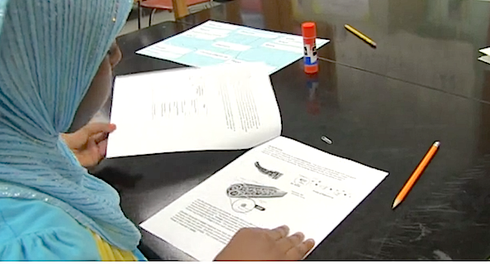
What’s Next
What's Next?
Session 5: Planning and Practice
Identify the implementation characteristics of SMP 1 and apply to planning and practice.
Give and receive feedback from colleagues in order to revise plans and refine practices
20
20

